Slide 1
KAE4-HA’s 40th Anniversary
Organized March 15, 1968
Cardinal Restaurant
Elizabethtown, Kentucky

Slide 2
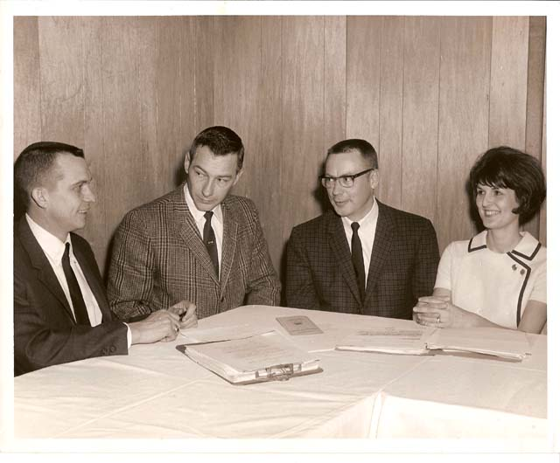
KAE4-HA’s First Officer Team
L – R : Paul Claiborne, President,; Wayne Baxter, 1st Vice President; Jerald Rose, 2nd Vice President and Betty Vernon, Secretary. Photo: Blanche Bushong

Slide 3
Significant pioneers in the development of KAE4-HA were Paul Claiborne, Paul Mills, Jerry Lement, George Mountjoy, Willard Gray, Ken Rase, Harold Rice, Fred Watson, John Rickett and Faith Niday. They framed our constitution and by-laws.

Slide 4
The committee that met with Dr. Macklin and Dr. Schneider to discuss the organization of KAE4-HA was John Swack, Paul Claiborne and Jerry Lement.

Slide 5
The nominating committee to begin KAE4-HA was Walter Jones, Ken Rase, Jo Nelda Cole, Ed May and Dick Lemaster.

Slide 6
The first slate of officers for election were: President – John Swack and Paul Claiborne
1st Vice President – Tom Curtsinger and Wayne Baxter
2nd Vice President – Jerry Rose and Jack Friar
Secretary- Treasurer – Deanna Craddock and Valda Richards

Slide 7
The remaining list included: Katherine Stephens, Harold Rice, Darrel Tichenor, Jerry Klement, Paul Throckmorton, Ray Russell, Ray Morgan and Emma Lou Hartledge. They were to be available if someone dropped out of the election.

Slide 8
The Training was mandatory but Association Business was optional -- Most participated!
In the early years KAE4-HA meetings were conducted in conjunction with 4-H In-Service Training that was held in Central Kentucky locations such as Barren River State Park and Mammoth Cave State Resort Park.

Slide 9
We Hosted Our First NAE4-HA National Meeting in Louisville, Kentucky in 1975 at the Executive Inns with attendance approaching 1,000

Slide 10
23 years later in 1998 KAE4-HA Hosted the NAE4-HA National Conference in Louisville at the Galt House with an attendance of nearly 1,400

Slide 11
KAE4-HA was heavily involved in the NAE4-HA Conference held in Norfolk, VA in 2002 as we celebrated the 100th Anniversary of 4-H

Slide 12
At 40 we are still growing and vibrant but we need everyone, including retirees, to keep up a full head of steam!

